Slide 1

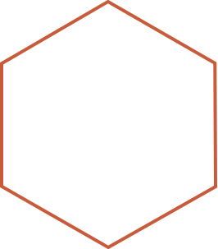

Image Processing Project
Dr.Bayan Alsaaidah

Slide 2

Project Aim
This code written to be the implementation of a graphical user interface (GUI) application. The GUI used to perform various image processing operations on the loaded image which is 'apple.jpg' in our project.
2

Slide 3


Implementation
Firstly lets start with (GUI) : We used MATLAB GUI development tool called GUIDE, It allows users to create GUIs by dragging and dropping components and setting their properties using a graphical interface. The code is generated using the GUIDE tool. You can open GUIDE by typing 'guide' in the command window, and it will open the design interface,that will allow you to build Your own project interface .
ANNUAL REVENUE GROWTH

Slide 4
Secondly the implementation of the code for my project required significant resources such as www.mathworks.com and the university lecture materials , this code is uploaded on Github which is a code hosting platform , Its used by over 100 million developers It lets you and others work together on projects from anywhere . My goal was to make the code as clean as possible and uploading it to online service so other developers can work with me too . So i began by uploading the selected image 'apple.jpg' into the project, then I added another axes to run the filterd img , and I have 10 buttons , each designed to serve a specific function.The detailed functionalities of these buttons will be discussed later on , In the next slide we going to start with the project code.
4

Slide 5
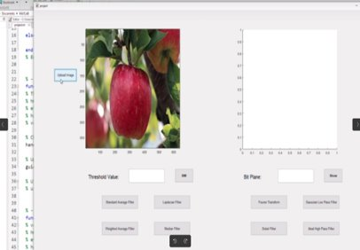
Upload Image Button
function pushbutton16_Callback(hObject, eventdata, handles)
[filename, pathname] = uigetfile('.jpg','.jpeg','*.png');
im = imread([pathname filename]);
imshow(im, 'Parent', handles.axes1);
setappdata(0,'im',im);
5

Slide 6
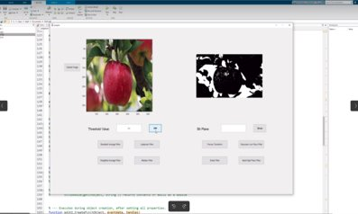
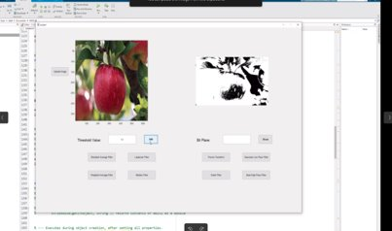
Black & White
Threshold Value : 0.5
Threshold Value : 0.2
6

Slide 7
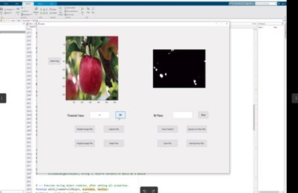
Black & White
Threshold Value : 0.9
function pushbutton10_Callback(hObject, eventdata, handles)
im=imread("apple.jpg");
x=str2num(get(handles.edit1,'string'));
im_bw=im2bw(im,x);
axes(handles.axes2);
imshow(im_bw);
7

Slide 8
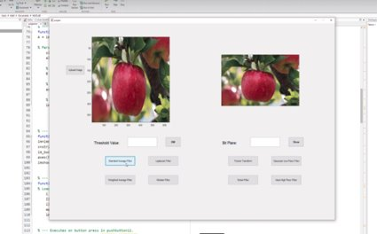
Standared Average Filter
function pushbutton12_Callback(hObject, eventdata, handles)
i=imread('apple.jpg');
w1=fspecial('average',[3 3]);
w2=fspecial('average',[5 5]);
j=imfilter(i,w1);
k=imfilter(i,w2,'replicate');
axes(handles.axes2);
imshow(j);
8

Slide 9
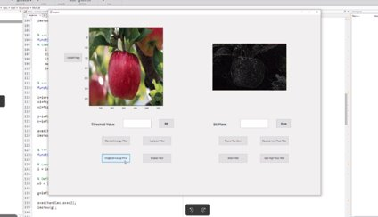
Weighted Average Filter
function pushbutton13_Callback(hObject, eventdata, handles)
i = imread('apple.jpg');
w3 = [-1, -1, -1; -1, 8, -1; -1, -1, -1];
g=imfilter(i,w3);
axes(handles.axes2);
imshow(g);
9

Slide 10
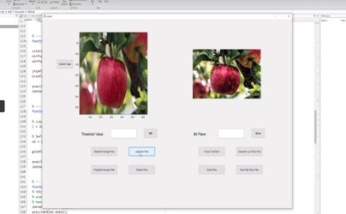
Laplacian Filter
function pushbutton9_Callback(hObject, eventdata,handle)​
A = imread('apple.jpg');​
sigma = 0.4;​
alpha = 0.5;​
B = locallapfilt(A, sigma, alpha);​
​axes2Handle = findobj('Tag', 'axes2'); ​
imshow(B);
10

Slide 11
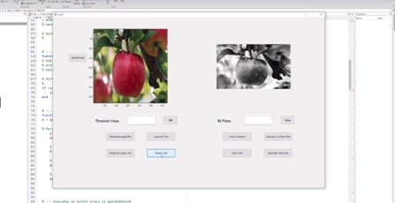
Median Filter
function pushbutton11_Callback(hObject, eventdata, handles)
i = imread('apple.jpg');
I1 = rgb2gray(i);
i1 = histeq(I1);
med1 = medfilt2(i1);
imshow(med1);
11

Slide 12
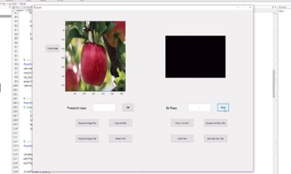
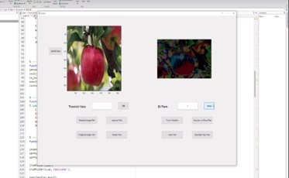
Bit Plane
Bit Plane : 1
Bit Plane : 7
12

Slide 13
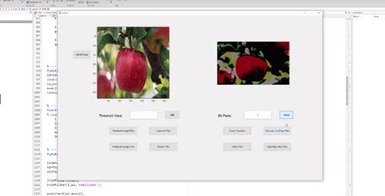
Bit Plane
Bit Plane : 8
function pushbutton18_Callback(hObject, eventdata, handles)
i=imread('apple.jpg');
z=str2num(get(handles.edit2,'string'));
j=i*0;
[r c]=size(i);
for x=1:r
for y=1:c
g=bitget(i(x,y),z);
j(x,y)=bitset(j(x,y),z,g);
end
end
axis(handles.axes2);
imshow(j);
13

Slide 14
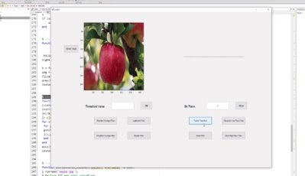
Fourier Transform
function pushbutton20_Callback(hObject, eventdata, handles)
img = imread('apple.jpg');
Ts = 1/50;
t = 0:Ts:10-Ts;
x = sin(2*3.1416*15*t) + sin(2*3.1416*20*t);
axis(handles.axes2);
imshow(x);
14

Slide 15
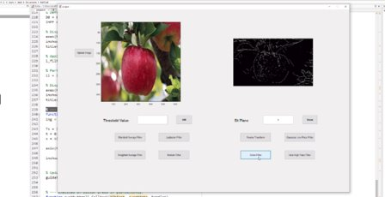
Sobel Filter
function pushbutton21_Callback(hObject, eventdata, handles)
a = imread('apple.jpg');
G = rgb2gray(a);
F = edge (G , 'sobel');
axis(handles.axes2);
imshow(F);
15

Slide 16
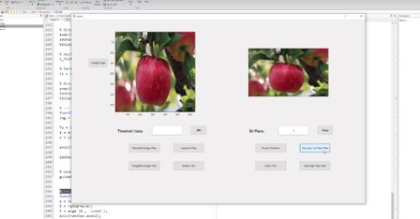
Gaussian Low Pass Filter
function pushbutton17_Callback(hObject, eventdata, handles)​
​hsize = 7; ​
sigma = 40; ​
​
h = fspecial('gaussian', [hsize hsize], sigma);​
img = imread('apple.jpg');​
filtered_img = imfilter(img, h);​
axes(handles.axes2);​
imshow(filtered_img);
16

Slide 17
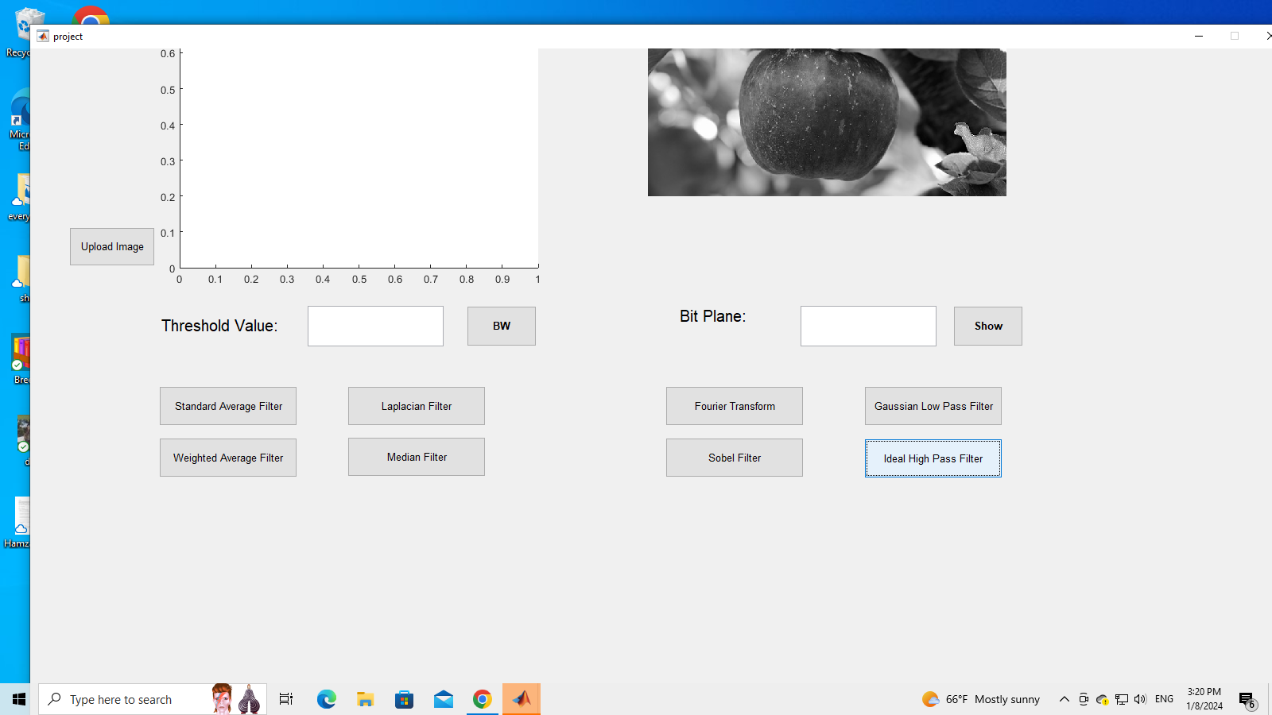
Ideal High Pass Filter
img = imread('apple.jpg');
img2 = rgb2gray(img);
% Get the size of the image
[rows, cols] = size(img2);
% Create an ideal high-pass filter in the frequency domain
radius = 50;
[x, y] = meshgrid(1:cols, 1:rows);
center_x = cols / 2;
center_y = rows / 2;
high_pass_filter = double(sqrt((x - center_x).^2 + (y - center_y).^2) > radius);
% Apply the high-pass filter in the frequency domain
img_fft = fft2(img2);
img_fft_filtered = img_fft .* high_pass_filter;
% Inverse Fourier transform to get the filtered image in spatial domain
img_filtered = ifft2(img_fft_filtered);
axes(handles.axes2);
imshow(uint8(abs(img_filtered)));
title(handles.axes2, 'High-Pass Filtered Image');

Slide 18
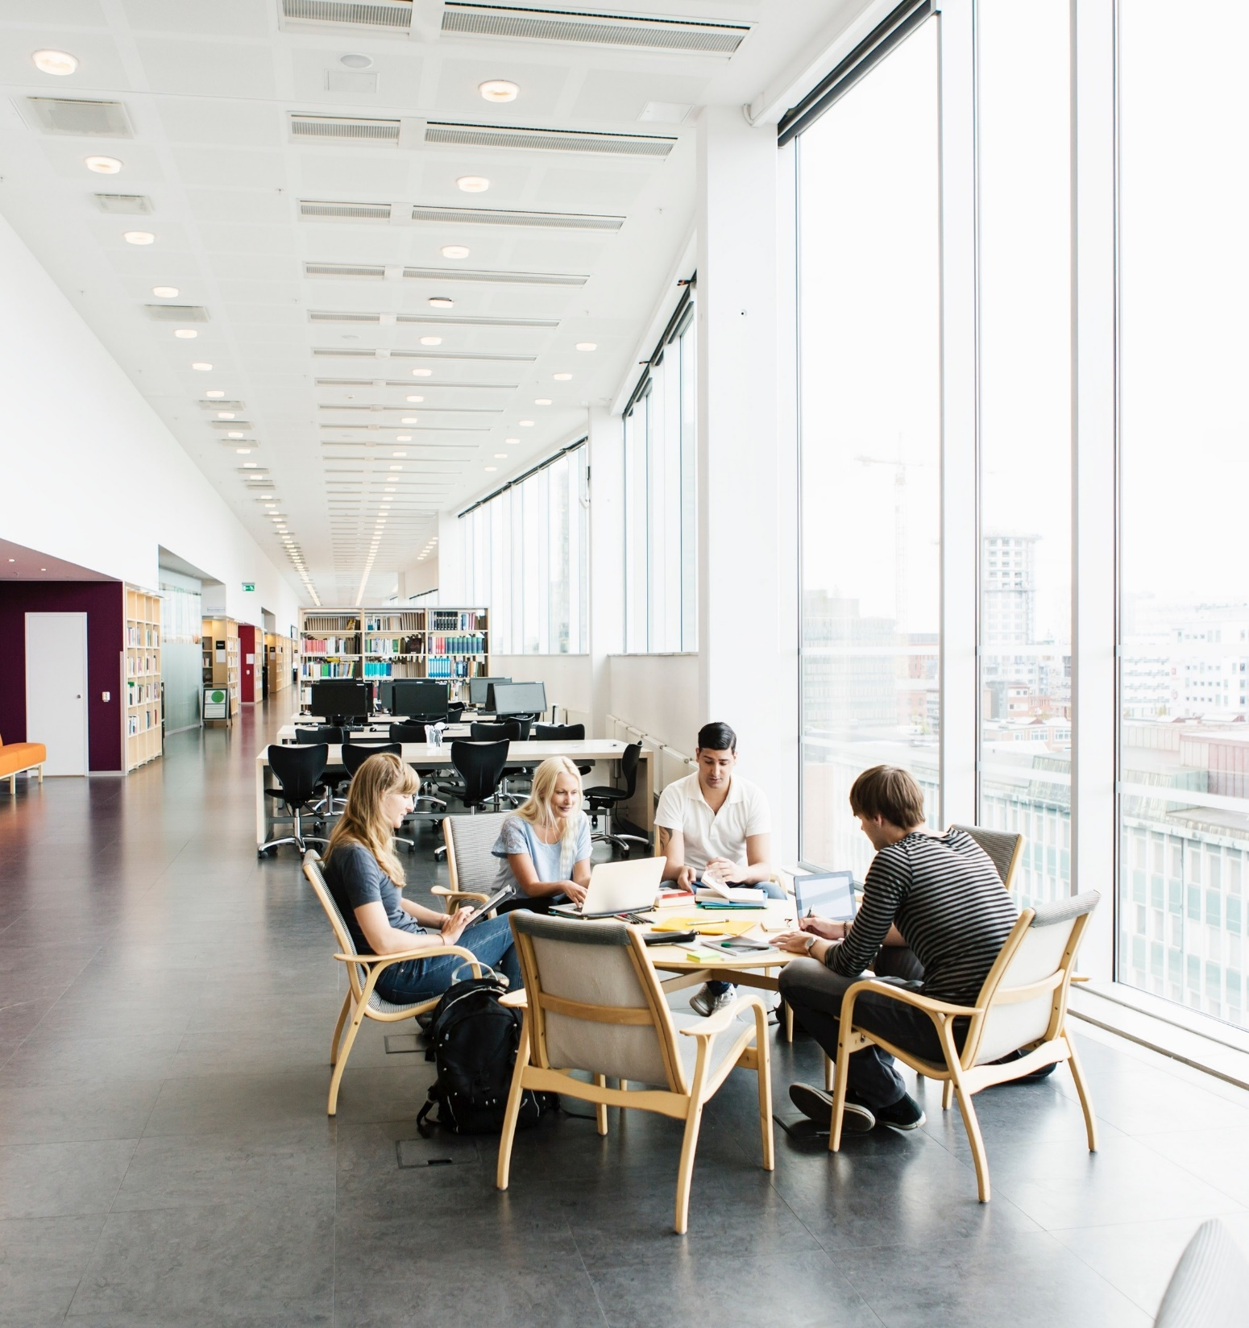
Sammary
This MATLAB code defines a graphical user interface (GUI) application for image processing. The GUI contains various buttons that trigger different image processing operations. The main functions include loading an image, applying local Laplacian filters, binary thresholding, histogram equalization, median filtering, averaging filters, and high-pass filtering. Additionally, there are functionalities for displaying images, applying Gaussian filters, bit-level manipulation, and frequency domain filtering. The GUI allows users to interact with these image processing techniques by clicking on specific buttons, each corresponding to a distinct operation.
17

